Slide 1
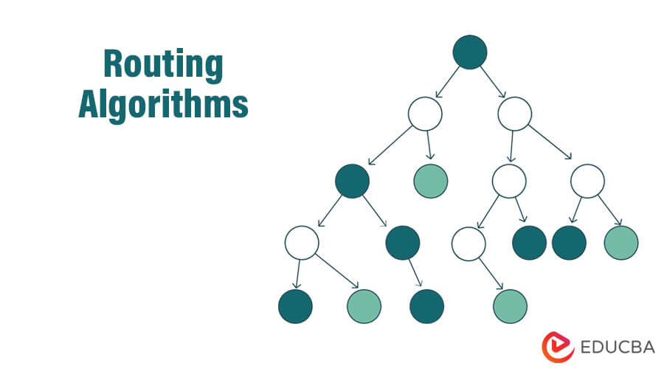
Lec -28, 30
NETWORK LAYER – Routing (Routing algorithms)

Slide 2
What are Routing Algorithms?
A routing algorithm is defined as the procedure that lays down the route or path to transfer data packets from the source to the destination.
It helps in directing Internet traffic efficiently. After a data packet leaves its source, it can choose among the many different paths to reach its destination.

Slide 3
UNICAST ROUTING PROTOCOLS
A routing table can be either static or dynamic. A static table is one with manual entries. A dynamic table is one that is updated automatically when there is a change somewhere on the Internet. A routing protocol is a combination of rules and procedures that lets routers on the Internet inform each other of changes.

Slide 4
Unicast means the transmission from a single sender to a single receiver.
It is a point-to-point communication between the sender and receiver Examples of Unicast Routing protocol such as TCP, HTTP, etc.
TCP is the most commonly used unicast protocol. It is a connection-oriented protocol that relies on acknowledgment from the receiver side.
HTTP stands for Hyper Text Transfer Protocol. It is an object-oriented protocol for communication.
In unicast routing protocols send the data packet or IP packets to a single recipient. An example of unicast routing protocols is IP(Internet protocol) and IPX(Internet packet exchange).

Slide 5
Example of common unicast routing protocol used in a 3-tier topology?
The transmission control protocol is the most common unicast protocol which is used in a 3-tier topology.
It is a connection-oriented protocol that relies on the acknowledgment sent from the receiver.

Slide 6
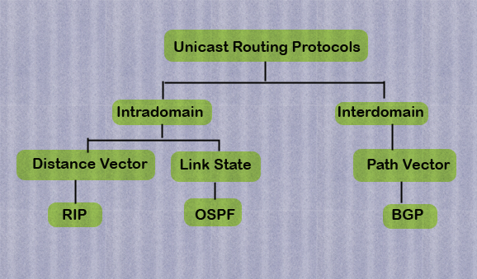
Types of unicasting Protocols.

Slide 7
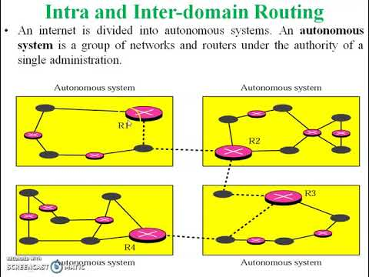

Slide 8
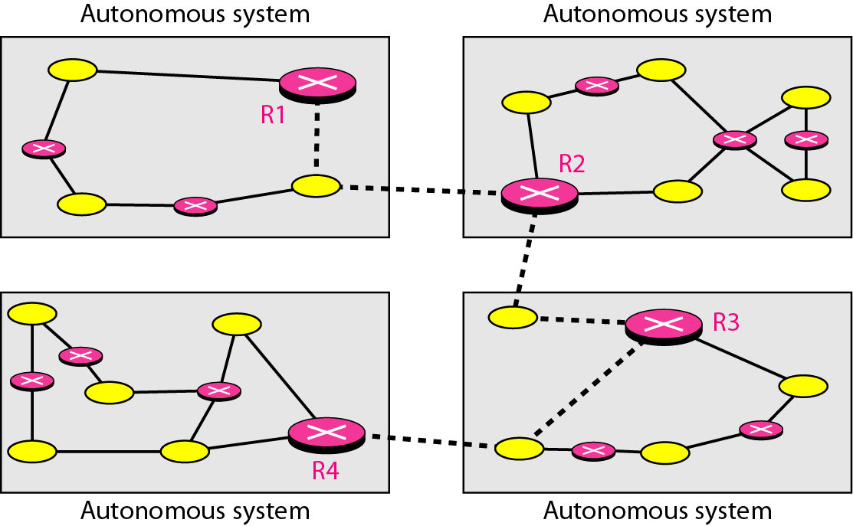
Figure 22.12 Autonomous systems

Slide 9
An autonomous system (AS) is a large network or group of networks that has a unified routing policy.
Imagine an AS as being like a town's post office. Mail goes from post office to post office until it reaches the right town, and that town's post office will then deliver the mail within that town.
Similarly, data packets cross the Internet by hopping from AS to AS until they reach the AS that contains their destination Internet Protocol (IP) address. Routers within that AS send the packet to the IP address.

Slide 10
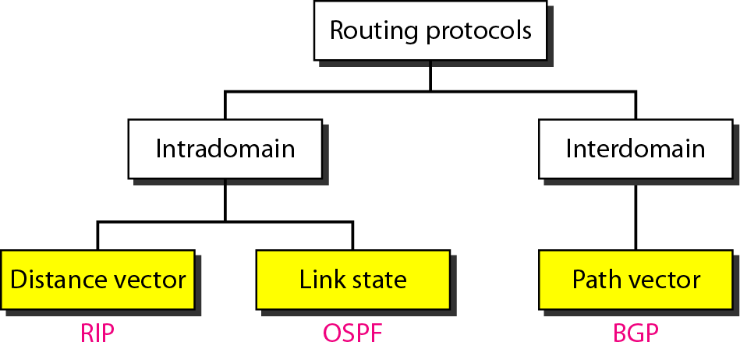
Popular routing protocols.

Slide 11
Figure 22.13 - Popular routing protocols.
Interdomain Routing is the protocol in which the routing algorithm works both within and between domains. Domains must be connected in some way, for hosts inside one domain to exchange data with hosts in other domains.
Intradomain Routing is the routing protocol that operates only within a domain. In other words, intradomain routing protocols are used to route packets within a specific domain, such as within an institutional network for e-mail or web browsing. Unlike interdomain routing protocols, it doesn't communicate with other domains.

Slide 12
Popular routing Protocol.
Routing Information Protocol (RIP) is a type of dynamic routing protocol that uses hop count as a routing metric to find the best path between the source and the destination network. It is based on the distance vector routing.
Hop count is the number of routers occurring between the source and destination network. The path with the lowest hop count is considered as the best route to reach a network and therefore placed in the routing table.
The Distance vector routing (DVR) operates by having each router maintain a table by giving the best-known distance to each destination and which path to use to get there. These tables are updated by exchanging information with the neighbors.

Slide 13
Explanation of Distance Vector Routing Algorithm.
It is used in computer networks to choose the optimal path for data to travel between nodes is the distance vector routing algorithm.
It works by exchanging data with its nearby nodes that are directly linked in order to compile a table of the most direct paths to every other node in the network.
Every node in the network keeps a routing table that details the distance to each target node as well as the subsequent hop node on the way there.
Normally, the distance is expressed in terms of the number of hops or the travel duration to the destination.
The Bellman-Ford algorithm is used by the Distance Vector Routing Algorithm to update the routing database. Each node sends its routing table to its neighbors on a regular basis, and they use the data they receive to update their own tables. Until every node has access to the most recent routing information, this procedure is repeated.

Slide 14
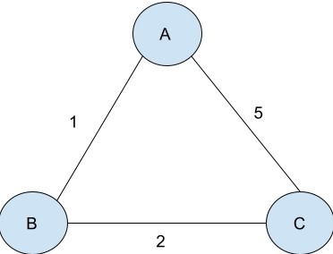
Example- Consider the following network; three routers are there: A, B, and C with AB=1, BC=2, and CA=5. Let's see the following steps to understand it better.

Slide 15
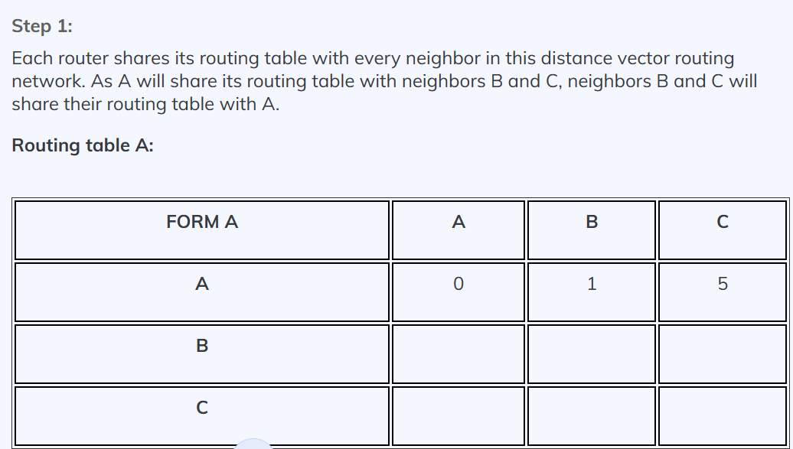
By taking an Example of DVR.
Step 1: -
Each router shares its routing table with every neighbor in this distance vector routing network. As A will share its routing table with neighbors B and C, neighbors B and C will share their routing table with A.

Slide 16
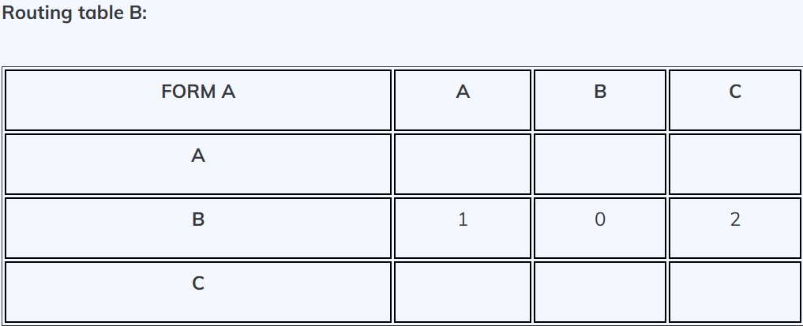

Slide 17
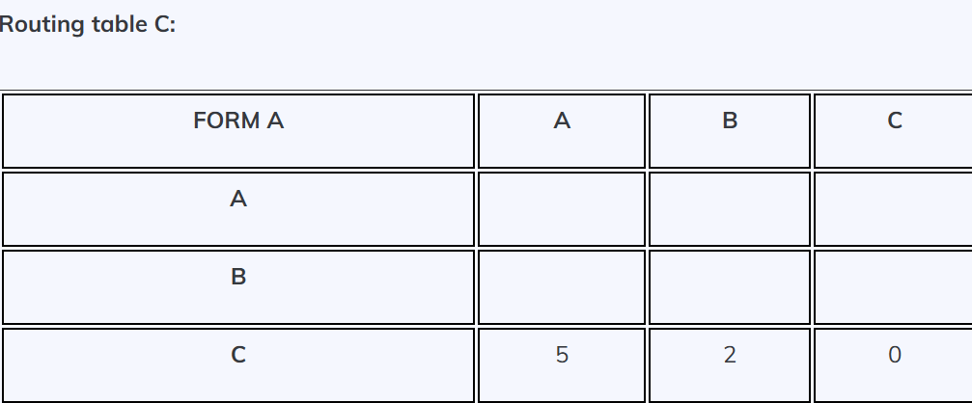

Slide 18
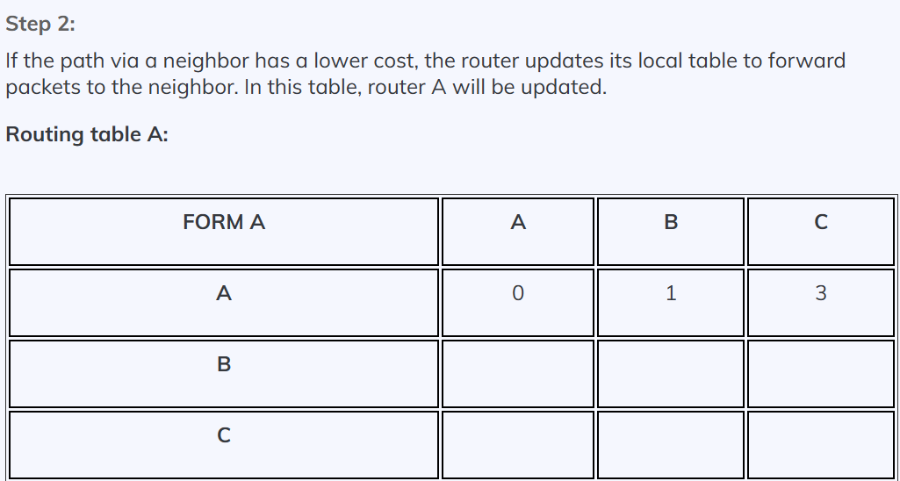

Slide 19
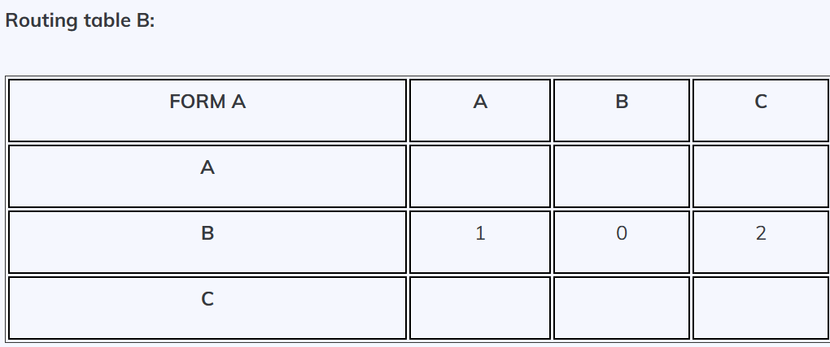

Slide 20
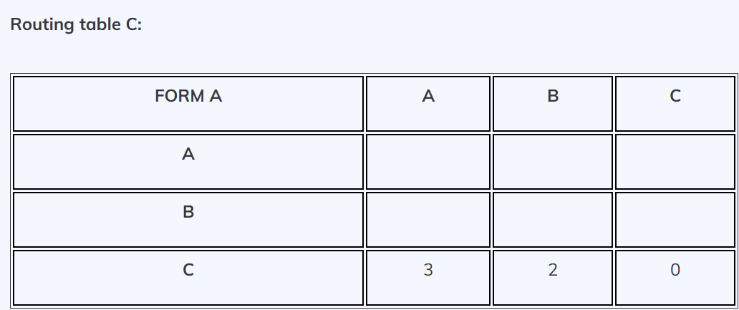

Slide 21
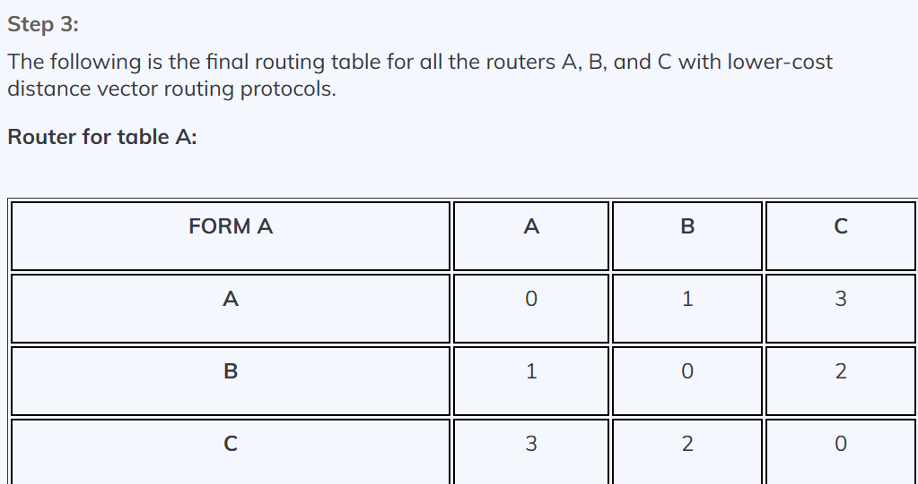

Slide 22
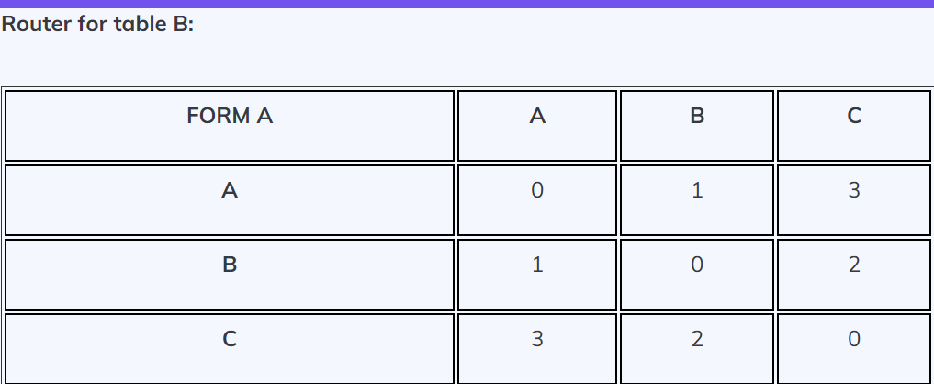

Slide 23
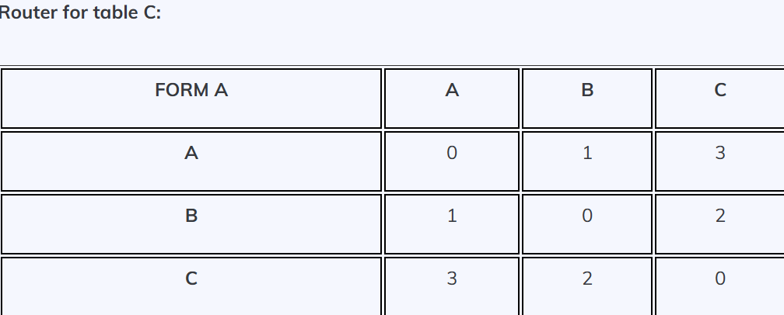

Slide 24
When does a node send its partial routing table (only two columns) to all its immediate neighbors?
Periodic Update: A node sends its routing table, normally every 30 s, in a periodic update. The period depends on the protocol that uses distance vector routing.
Triggered Update: A node sends its two-column routing table to its neighbors anytime there is a change in its routing table. This is called a triggered update.
The change can result from the following:
1. A node receives a table from a neighbor, resulting in changes in its own table after updating.
2. A node detects some failure in the neighboring links which results in a distance change to infinity.

Slide 25
Count to Infinity .
A problem with distance-vector routing is that any decrease in cost (good news) propa gates quickly, but any increase in cost (bad news) will propagate slowly.
For a routing protocol to work properly, if a link is broken (cost becomes infinity), every other router should be aware of it immediately, but in distance-vector routing, this takes some time. The problem is referred to as count to infinity. It sometimes takes several updates before the cost for a broken link is recorded as infinity by all routers.

Slide 26
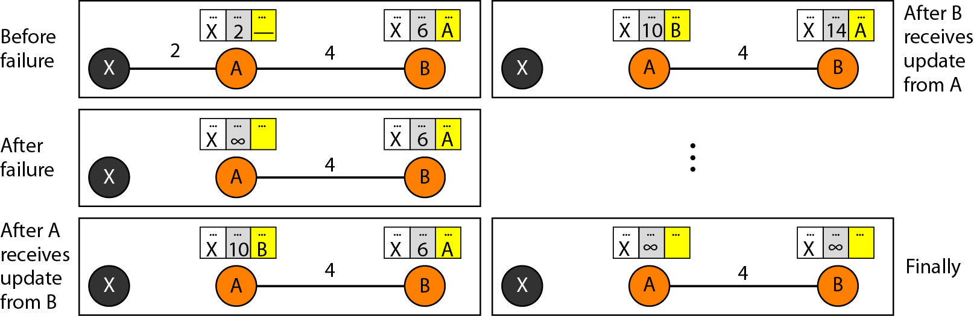
Figure 22.17 Two-node instability

Slide 27
Defining Infinity .
The first obvious solution is to redefine infinity to a smaller number, such as 100.
For our previous scenario, the system will be stable in less than 20 updates. As a matter of fact, most implementations of the distance vector protocol define the distance between each node to be I and define 16 as infinity.
However, this means that distance vector routing cannot be used in large systems.
The size of the network, in each direction, can not exceed 15 hops.

Slide 28
Three Keys to understand the working of Distance Vector Routing Algorithm .
The three keys to understanding the working of the Distance Vector Routing Algorithm are:-
Distance Metric.
Routing Table.
Bellman-Ford Algorithm.

Slide 29
Distance Metric - To find the best route to a destination node, the Distance Vector Routing Algorithm employs a distance metric. The number of hops, the bandwidth, or the latency are some examples of different ways to measure the distance metric.
Routing Table -Every node in the network keeps a routing table, which includes details on the most efficient route to take to get to each destination node. The next hop node and the travel time to the target node are both listed in the routing table. Nodes communicate with the neighbors with whom they are directly linked to update their routing tables on a regular basis.
Bellman-Ford Algorithm -To determine the best route to a target node, the Distance Vector Routing Algorithm employs the Bellman-Ford algorithm. Until convergence is achieved, the algorithm iteratively updates the distance to each network node.

Slide 30
Advantages of Distance Vector Routing.
For a typical LAN setting, bandwidth requirements are minimal.
Compared to other routing techniques, requires less hardware and computing power.
Reliable and tested approach (distance vector was the original routing algorithm)
Simple to use and administer.

Slide 31
Routing Information Protocol (RIP)
It is an Intradomain routing protocol used inside an autonomous system. It is a very simple protocol based on distance vector routing.
RIP implements distance vector routing directly with some considerations:
1. In an autonomous system, we are dealing with routers and networks (links). The routers have routing tables; networks do not.
2. The destination in a routing table is a network, which means the first column defines a network address.
3. The metric used by RIP is very simple; the distance is defined as the number of links (networks) to reach the destination. For this reason, the metric in RIP is called a hop count.
4. Infinity is defined as 16, which means that any route in an autonomous system using RIP cannot have more than 15 hops.
5. The next-node column defines the address of the router to which the packet is to be sent to reach its destination.

Slide 32
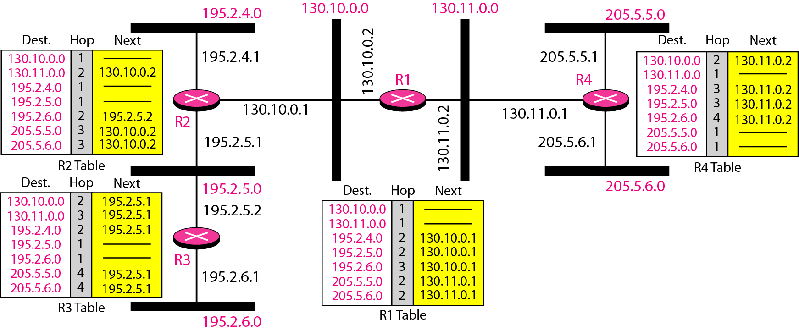
Figure 22.19 Example of a domain using RIP

Slide 33
Link state routing.
Link State Routing is a type of routing protocol. It is used in computer networks to determine the shortest path between two nodes. In Link State Routing, each router maintains a detailed view of the entire network, and routers exchange information about the state of their links.
List of nodes and links, how they are connected including cost (metric), and condition of the links (up or down).

Slide 34
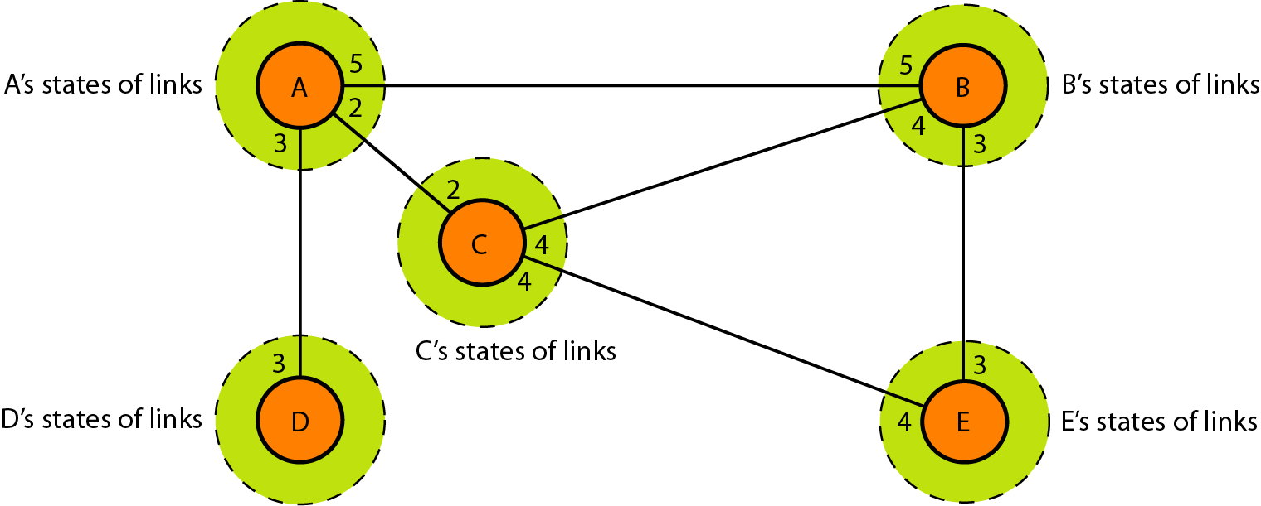

Slide 35
Build routing table
In link state routing, four sets of actions are required to ensure that each node has the outing table showing the least-cost node to every other node.
Creation of the states of the links by each node, called the link state packet (LSP).
2. Dissemination of LSPs to every other router, called flooding, in an efficient and
reliable way.
3. Formation of a shortest path tree for each node.
4. Calculation of a routing table based on the shortest path tree.
Creation of Link State Packet (LSP) -
A link state packet can carry a large amount of information.
For the moment, however, we assume that it carries a minimum amount of data:
node identity
list of links
sequence number,
age.
The first two, node identity and the list of links, are needed to make the topology. The third, sequence number, facilitates flooding and distinguishes new LSPs from old ones.
The fourth, age, prevents old LSPs from remaining in the domain for a long time

Slide 36
LSPs are generated on two occasions:
When there is a change in the topology of the domain
On a periodic basis
Flooding of LSPs-
The creating node sends a copy of the LSP out of each interface.
A node that receives an LSP compares it with the copy it may already have.
If the newly arrived LSP is older than the one it has, it discards the LSP. If it is newer, the node does the following:
a. It discards the old LSP and keeps the new one.
b. It sends a copy of it out of each interface except the one from which the packet arrived.

Slide 37
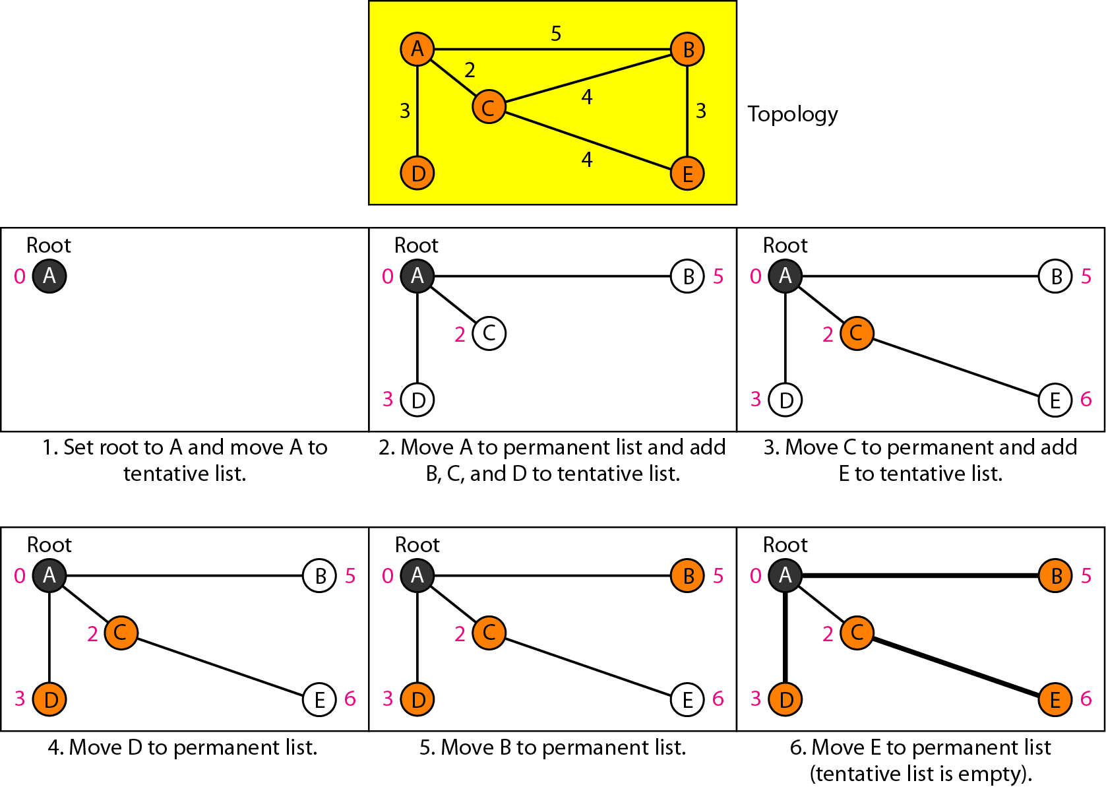
Example of formation of shortest path tree.

Slide 38
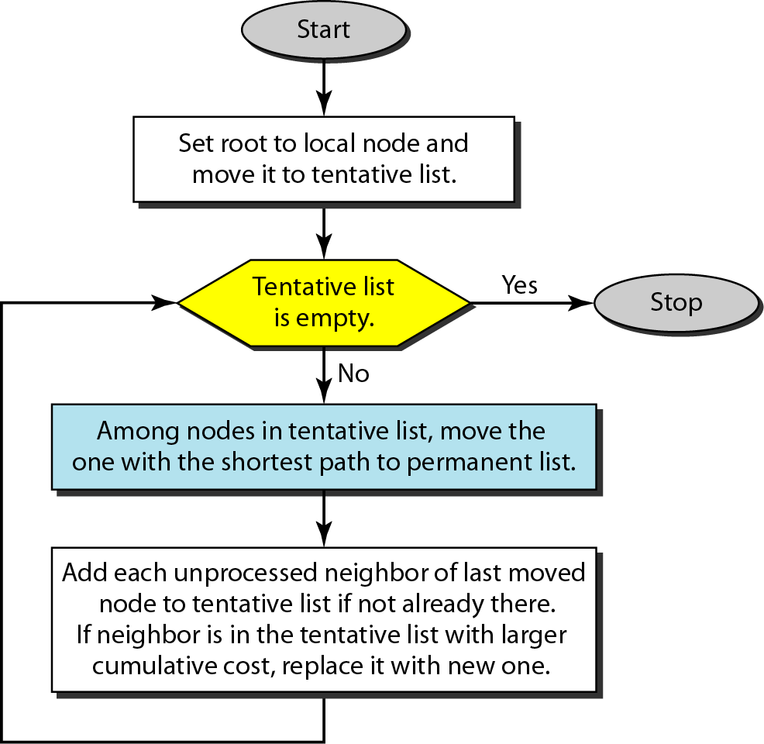
Figure 22.22 Dijkstra algorithm

Slide 40
OSPF.
The Open Shortest Path First (OSPF) protocol is an intradomain routing protocol based on link state routing. Its domain is also an autonomous system.
OSPF (Open Shortest Path First) is a router protocol used to find the best path for packets as they pass through a set of connected networks.
The OSPF (Open Shortest Path First) protocol is one of a family of IP Routing protocols and is an Interior Gateway Protocol (IGP) for the Internet, used to distribute IP routing information throughout a single Autonomous System (AS) in an IP network.

Slide 41
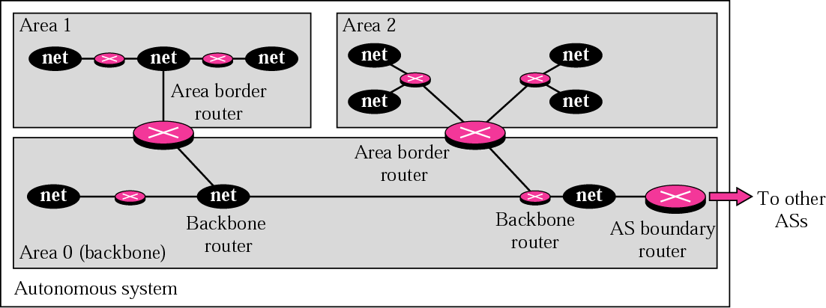
Figure 14.19 Areas in an autonomous system

Slide 42
OSPF Protocol.
Routers running OSPF protocol have to establish neighbor relationships before exchanging routes. Because OSPF is a link-state routing protocol, neighbors don’t exchange routing tables. Instead, they exchange information about network topology.
Each OSPF router then runs on the Dijkstra algorithm to calculate the best routes and adds those to the routing table. Because each router knows the entire topology of a network, the chance for a routing loop to occur is minimal.

Slide 43
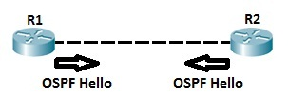
OSPF Neighbors .
OSPF routers need to establish a neighbor relationship before exchanging routing updates.
OSPF neighbors are dynamically discovered by sending Hello packets from each OSPF-enabled interface on a router. Hello packets are sent to the multicast IP address of 224.0.0.5.
The process is explained in the following figure:-

Slide 44
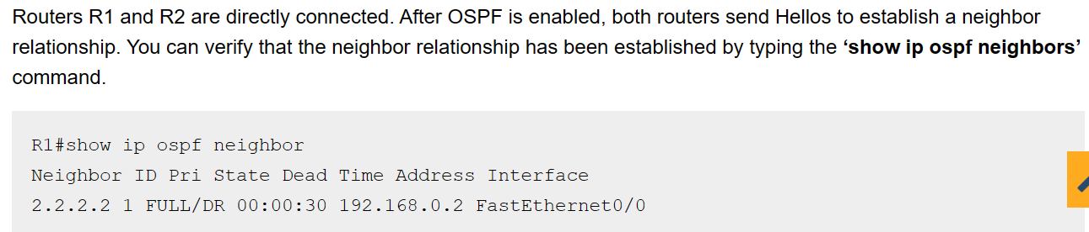
OSPF command.

Slide 45
Metric in OSPF .
OSPF allows the administrator to assign a cost called metric.
The metric can be based on the type of service- minimum delay, maximum throughput, and so on.
Therefore, a router can have multiple routing tables based on different type of service.

Slide 46
BGP Protocol.
Border Gateway Protocol (BGP) is an interdomain routing protocol using path vector routing. It first appeared in 1989 and has gone through four versions.
Border Gateway Protocol (BGP) refers to a gateway protocol that enables the internet to exchange routing information between autonomous systems (AS).

Slide 47
Types of BGP .
Internal (iBGP) - Runs between routers in the same autonomous system.
External (eBGP) - Runs between routers in different autonomous systems.
A BGP session is a TCP connection formed between two BGP routers over which BGP messages are exchanged. There are three types of BGP sessions: internal BGP (IBGP), external BGP (EBGP), and confederation external BGP (Confed-EBGP).

Slide 48
BGP session .
When establishing a BGP session, the routers use the smaller Hold Time value contained in the two router's OPEN messages. The Hold Time value must be at least three seconds, or zero. For Cisco routers, the default hold timer is 180 seconds.

Slide 49
Path Attributes .
Well Known attribute
Mandatory
Discretionary
Optional attribute
Transitive
Non-transitive

Slide 50
BGP Sessions .
Using TCP connections—reliable
Last for a long time so it is called semi-permanent connections.

Slide 51
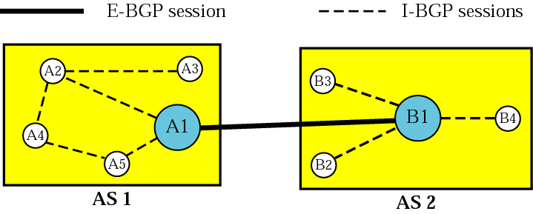
Internal and external BGP sessions .

Slide 52
PATH VECTOR ROUTING.
Path vector routing is similar to distance vector routing. There is at least one node, called the speaker node, in each AS that creates a routing table and advertises it to speaker nodes in the neighboring Ass.
The problem in the distance vector is node instability.
The problem in link state routing is heavy traffic due to flooding and extra resources required for generating routing tables.

Slide 53
Steps in path vector Routing
Initialization
Sharing
Updating– Loop prevention, policy routing, optimum path.

Slide 54
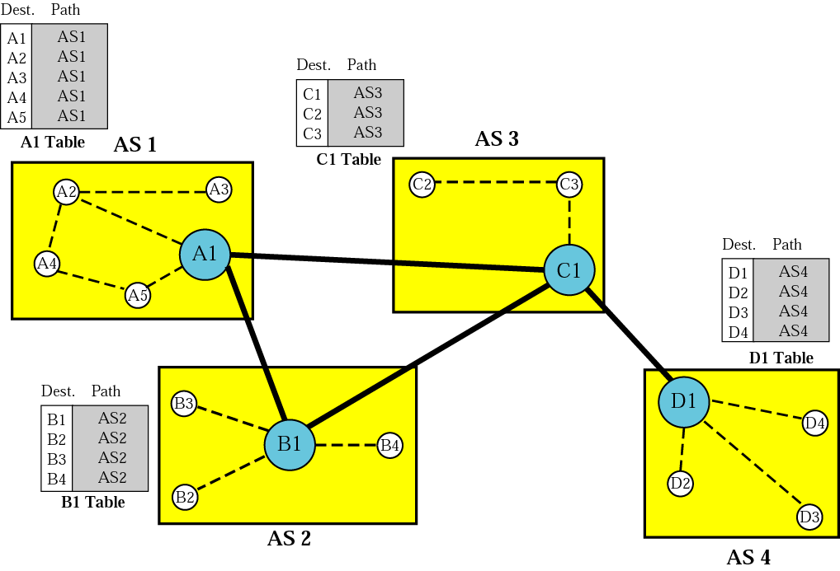
Initial routing tables in path vector routing.

Slide 55
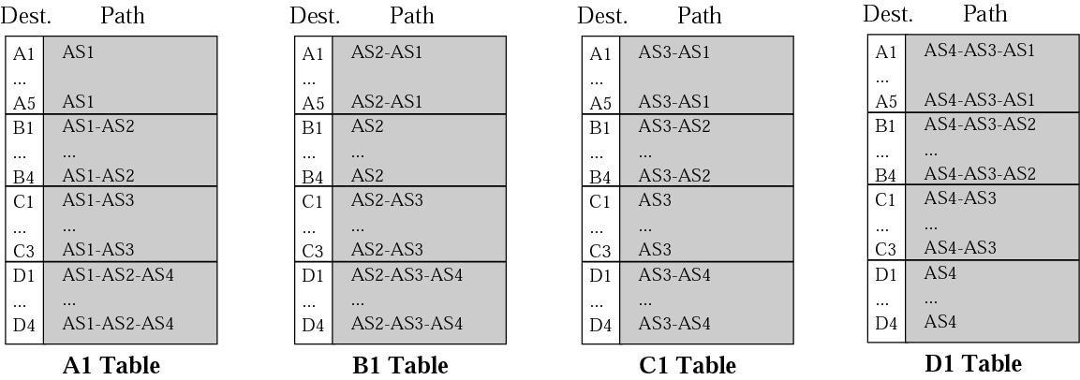
Stabilized tables for four autonomous systems.

Slide 56
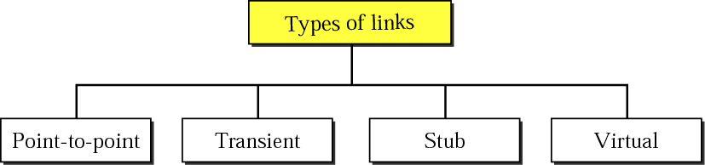
Figure 14.20 - Types of links

Slide 57
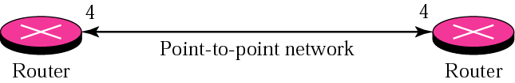
Figure 14.21 -Point-to-point link

Slide 58
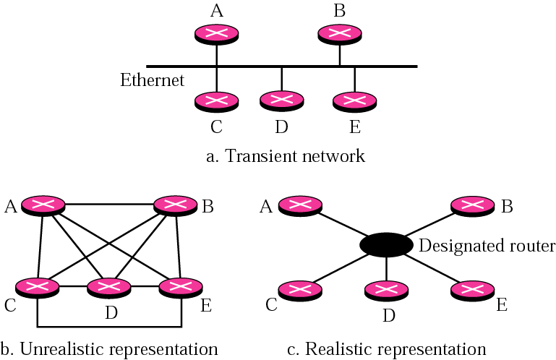
Transient link

Slide 59
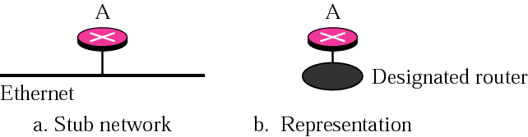
Figure 14.23 Stub link

Slide 60
Advantages of OSPF.
It is based on an open standard. It can run on most routers.
It supports VLSM and route summarization for a hierarchical design.
It supports load balancing with equal-cost routes for the same destination.
It supports networks of all sizes.

Slide 61
Advantages of BGP .
Using BGP for LAN-WAN routing can offer several benefits for a multi-homed network, such as –
Improved performance.
Enhanced reliability.
Increased security.

Slide 62
What is the concept of a flooding algorithm?
Flooding is used in computer networking routing algorithms where each incoming packet is transmitted through every outgoing link, except for the one on which it arrived.
Flooding algorithms are guaranteed to find and exploit the shortest paths to the sent packets, as floods use each route in a network naturally.

Slide 63
Fragmentation
Fragmentation is a type of process in which is used to divide packets into smaller pieces (fragments) so that the resulting pieces can travel across a link with a smaller maximum transmission unit (MTU) than the original packet size.

Slide 64

Thanks

